Slide 1
Project title: Pran distributor product delivery management
Name: Rakibul Alam
ID number: 1000355
Instructor: Mohammad Azizur Rahman
Notes:
We designed this template so that each member of the project team has a set of slides with its own theme. Members, here’s how you add a new slide to just your set:
Mark where you want to add the slide: Select an existing one in the Thumbnails pane, click the New Slide button, then choose a layout. The new slide gets the same theme as the other slides in your set.
Careful! Don’t annoy your fellow presenters by accidentally changing their themes. That can happen if you choose a different theme from the Design tab, which changes all of the slides in the presentation to that look.

Slide 2
Contents
Introduction
Overview of the Project
Aim and objects
Functional and non Functional Requirements
Analysis and Design
Use case diagram
Class diagram
ERD
Activity Diagram
Testing
Unit Testing
Integration Testing
Strengths and weakness
Learning from this project
Further development
Conclusion

Slide 3
Introduction
In this presentation, I am going to discuss my project which is mainly a desktop application for Pran Distributor Product Delivery Management. Using this application, the distributor will be able to manage his product delivery more easily and efficiently. Now, I am going to start my presentation.

Slide 4
Overview of the Project
The proposed Product delivery management system is developed for a specific company’s distributor where a distributor calculate, generate report and analysis market situation using the application. This is give him a computerized system rather than working with manual system. By using the system, his job will be more productive.

Slide 5
Aims and Objectives
Aims
Objectives
To make the delivery system easier
To make the calculation system efficient
To improve productivity of the business
To store all product data in a database
To improve decision making for the distributor
Easy to maintain delivery
Auto calculate of selling products
Product adding, updating and deleting facilities
Facilities of generating monthly, yearly product selling report.
Option to print immediate selling product information.
Option to Distributor easily find each category products.

Slide 6
Functional and Non Functional Requirements
Functional Requirements
Non Functional Requirements
Manage product
Auto cost calculation
Generate selling product table
Update product category
Validation and verification
Maintainability
Reliability
Efficiency
Time effective

Slide 7
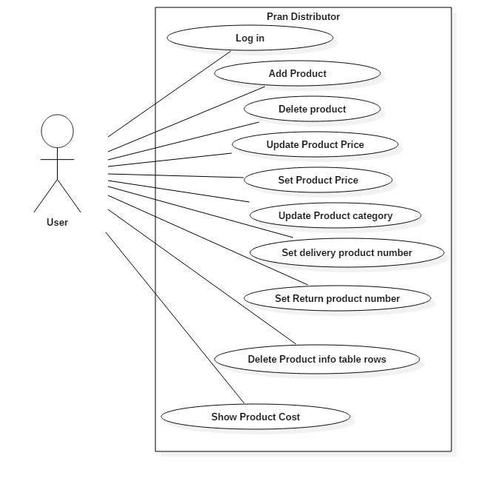
Use case Diagram – User and System

Slide 8
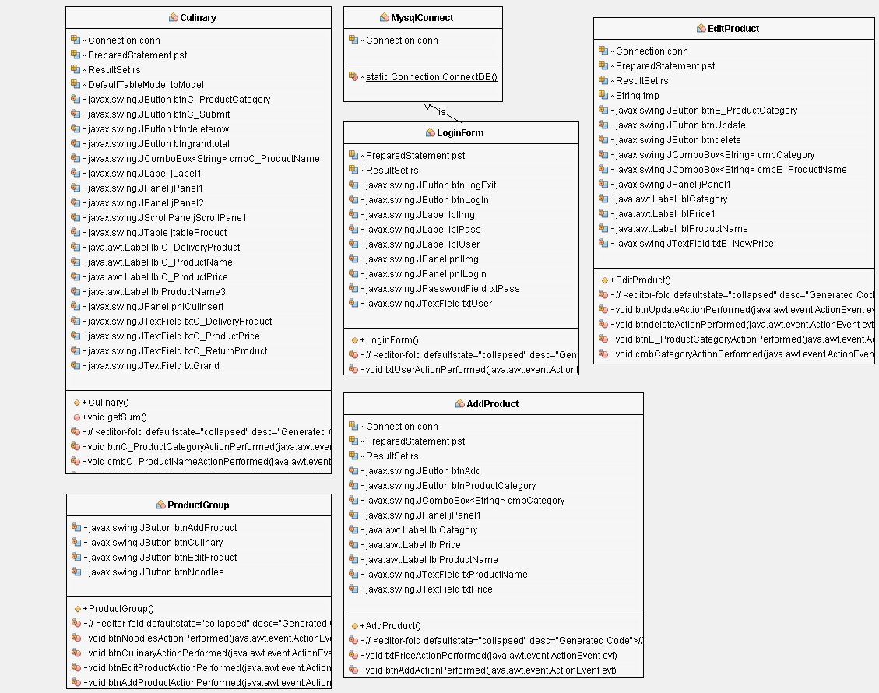
Class Diagram

Slide 9
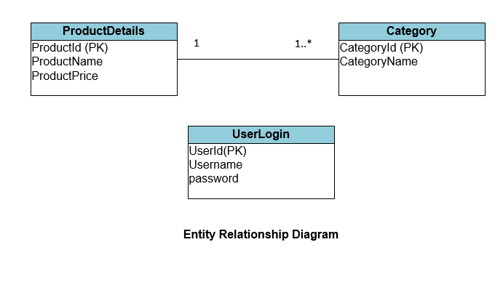
Entity Relationship Diagram

Slide 10
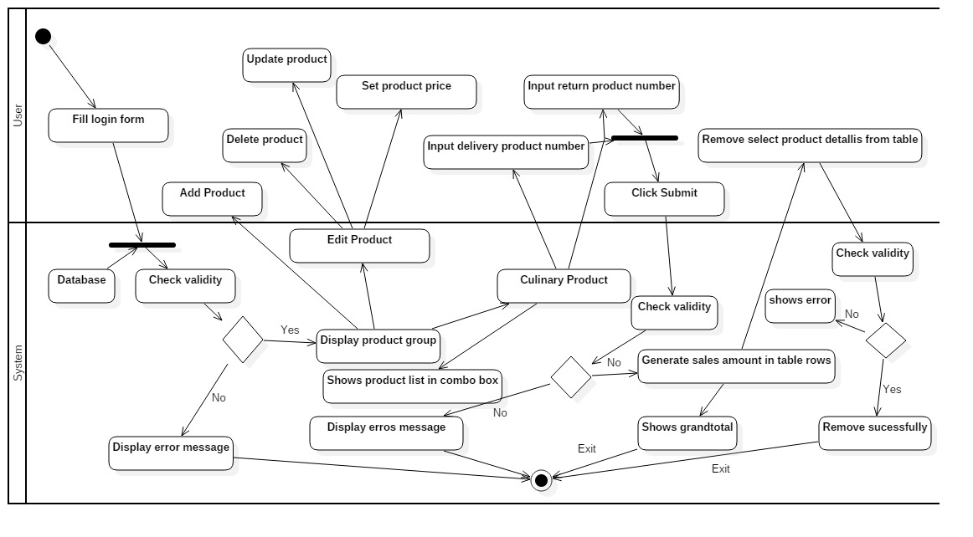
Activity Diagram

Slide 11
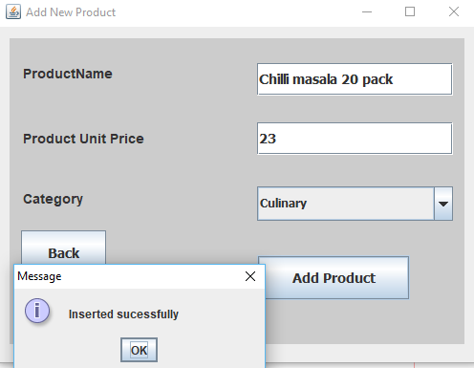
Unit Testing
Unit Test 6 |  | Test class: EditProduct | Designed By: Rakibul Alam
Data Source: user entry |  | Objective: Basic functionality Testing | Tester: Rakibul Alam
Test Case | Description | Tasks | Expected Result | Actual Result
6.1 | Basic functionality testing: ‘Add new Product by user’ | Enter new product name Product name: Chilli masala 20 pack | Value is added to the productdetails table in database | Same

Slide 12
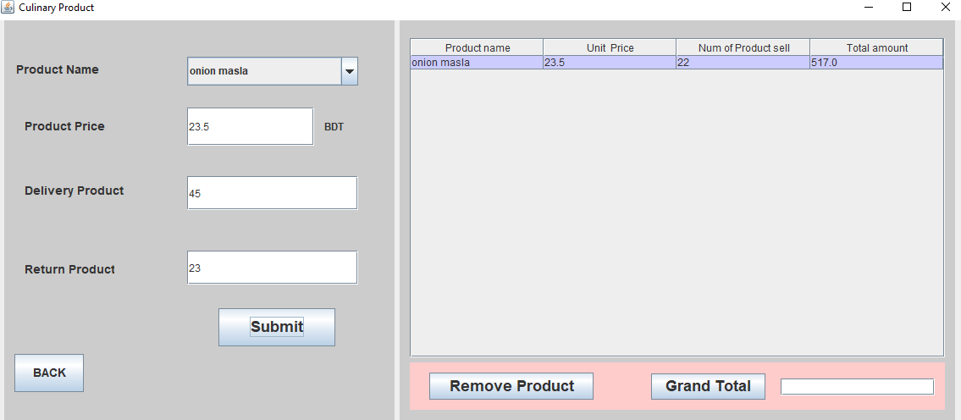
Integration Testing
Integration Test 3 |  | Tests Class: Culinary | Designed By: Rakibul Alam
Data Source: user entry |  | Objective: Basic functionality Testing | Tester: Rakibul Alam
Test Case | Description | Tasks | Expected Result | Actual Result
1.1 | Basic functionality testing: ‘Showing product details in table.’ | Click Submit button. | Cost of products will be shown on a table row. | Same

Slide 13
Strengths and weakness
Strengths
Weakness
User friendliness
Auto calculation of payment
Normalized database
All must have needed functions and features
Not generating report
Single level user
No graphical chat
Passwords are not encrypted

Slide 14
Further Development
Categorized all products
Report with graphical chat
Better validation
Store management

Slide 15
Learning Outcome from this project
In this project developing journey, I have learnt lot of thing. How to develop java project using Netbeans IDE and connect it with database. How to keep information in table at real time and how to shows information in it, I have leant during developing the project. It was a test driven development process.

Slide 16
Conclusion
I have tried my best to complete this project. I think, I have become successful in getting my project understandable to you.
Thank you!!!

